Slide 1
Addiction: focus on opioids and new insights into marijuana
Gisele J. Girault, M.D.
First Choice Healthcare
Columbia, South Carolina

Slide 2
introduction
Substance use disorder definitions and statistics
Risk factors for SUD: genetic and developmental
SUD in the workplace
Alcohol use disorder
Opioid use disorder
Update on marijuana

Slide 3
Definition of addiction
Addiction is a primary, chronic disease of brain reward, motivation, memory and related circuitry.
Dysfunction in these circuits leads to the characteristic biological, psychological, social and spiritual manifestations.
This is reflected in an individual pathologically pursuing reward and/or relief by substance use and other behaviors.
American Society of Addiction Medicine

Slide 4
Definition of addiction
Impaired control
Greater use
Failed attempts to reduce or decrease
Spending greater amounts of time in obtaining , using, recovering from the substance
Craving is an intense desire to or urge

Slide 5
Definition of addiction
Social Impairment
Failure to fulfill major role obligations
Recurrent social or interpersonal problems
Important social, occupational or family activities are reduced or given up

Slide 6
Definition of addiction
Risky use of the substance
Recurrent substance use in situations in which it is physically hazardous
Continued use of the substance despite knowledge of having a persistent or recurrent physical or psychological problem that is caused or exacerbated by the substance
Tolerance and withdrawal
Requiring a markedly increased dose to achieve the desired effect
Withdrawal is a syndrome occurs when the blood or tissue concentration of the substance deciles, after prolonged heavy use.

Slide 7
Statistics of substance use disorder in the US
20.5 million Americans had a SUD in 2015 with 2 million related to prescription opioids
In 2015 276,000 adolescents were using pain medications illegally
Adults age 45-54 have the highest overdose rates

Slide 8
Statistics of substance use disorder in US
Drug overdose is the leading cause of accidental death in the US
52,404 lethal drug overdoses in 2015
20,101 overdose deaths related to prescription pain medications

Slide 9
Common Substances of Abuse
Prescription sedatives
Prescription stimulants
Steroids
Synthetic cannabinoids
Synthetic Cathinones
Tobacco
Alcohol
Cocaine
Hallucinogens
Heroin
Inhalants
Ketamine
LSD
Marijuana
MDMA
Methamphetamine
OTC cold medicines
PCP
Prescription Opioids

Slide 10
SUD is a brain disorder
The addicted brain is functionally different from the non addicted brain
Prolonged substance use causes pervasive changes in brain chemistry
These changes persist long after cessation of using the substance
The brain has memories of previous rewards
These memories initiate a biological and behavioral response to external cues

Slide 11
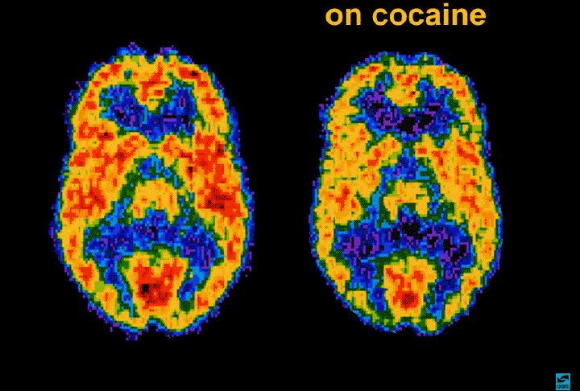

Slide 12
Risk factors for developing SUD
The risk of developing a SUD is 50% genetic
Certain genes may predispose a person to abuse or be protective in preventing abuse
Addiction is also a developmental disease; it typically begins in childhood or adolescence
.

Slide 13
Environmental Risk factors
Childhood aggressive behavior
Poor social skills
Availability of drugs at home or at school
Lack of parental supervision
Drug experimentation
Community poverty
Physical and/or sexual abuse
Addiction in close family members

Slide 14
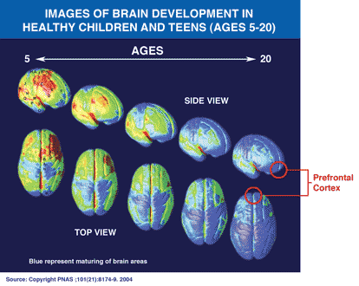

Slide 15
Functions of the prefrontal cortex
Executive function
Differentiate conflicting thoughts
Determine good vs. bad
Future consequences of current activities
Working toward a defined goal
Prediction of outcomes
Social control

Slide 16
Addiction Changes brain circuits
Control
Control
Salience
Salience
Drive
Drive
Memory
Memory

Slide 17
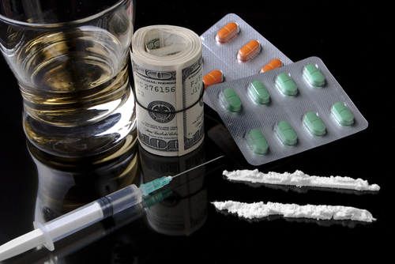
Substance use in the workplace

Slide 18
Cost of drug abuse in the workplace
Drug abuse cost US employers $81 billion yearly
$25-30 billion in lost productivity due to absenteeism
$25 billion in increased healthcare costs
80% of drug abusers steal from their employer or other employees to support their habit
77% of drug abusers are employed

Slide 19
SUD impacts on the workplace
Increased work related accidents
Employee drug use increases medical claims
Increased medical claims increases medical insurance premiums
Employees with SUD are 5x more likely to file a WC claim
WC claims have higher payouts

Slide 20
Sud impact on the workplace
Substance use leads to increased absenteeism, increased sick days
Increased employee theft
Being intoxicated on the job leads to product defects, missed deadlines, incomplete projects, inaccurate work
Increased equipment damage and loss
If you have addicted employees, you have drug dealers in your company

Slide 21
SUD in the workplace
Drug dealing is a crime, but there are other types of crimes
Corporate theft
Stealing from other employees
Ties to organized crime
Violence toward other employees, blackmail
Drug Free Workplace Act of 1988

Slide 22
Sud in the workplace
3-4x more likely to injury themselves or another employee
5x more likely to be in an accident off the job
Incur 300% more medical cost than their non drug using counterparts

Slide 23
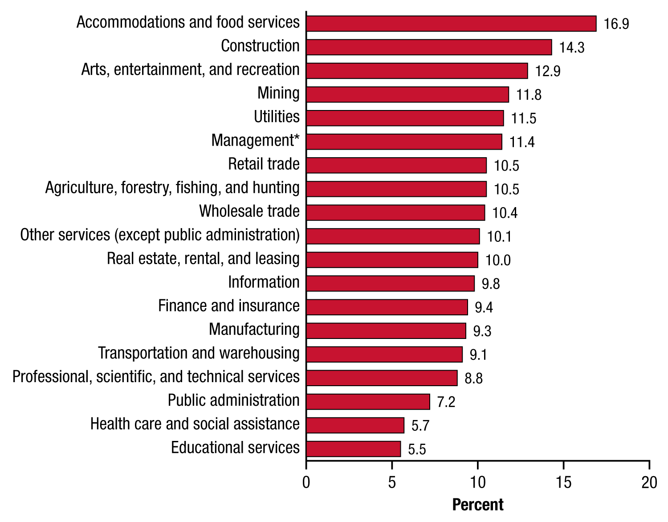
INDUSTRIES WITH THE HIGHEST SUBSTANCE USE DISORDER

Slide 24
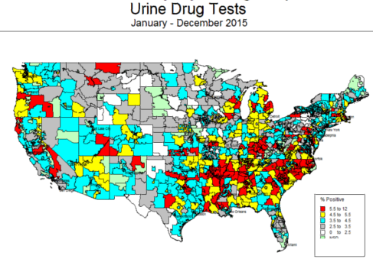

Slide 25
Alcohol

Slide 26
Alcohol use disorder
Drinking more/longer than intended
Wanted to cut down but couldn’t
Spending a lot of time drinking
Wanted a drink so badly-craving
Drinking caused trouble with job or family
Continued to drink in spite of trouble
Given up activities in order to drink
Gotten into a dangerous situation
Continuing to drink in spite of health issues
Have to drink more to get the same effect
Experience withdrawal when the ETOH wears off

Slide 27
Statistics on alcohol
In 2015 15.1 million adults had AUD
An estimated 623,000 youth age 12-17 had AUD in 2015
88,000 alcohol related deaths in 2015
4th leading preventable cause of death
In 2014 31% of traffic fatalities were due to alcohol impaired driving

Slide 28
Alcohol effects on health
Brain; mood, behavior and cognitive dysfunction
Cardiac; myopathy, arrhythmias, MI, CVA
Hepatic; steatosis, hepatitis, fibrosis, cirrhosis
Pancreas; pancreatitis
Cancer; mouth, esophagus, throat, liver, breast
Immune System; pneumonia, TB,

Slide 29
Industries with the highest alcohol use disorder

Slide 30
Opioids

Slide 31
Opioid use disorder statistics
Economic burden $78.5 billion a year
90 opioid overdose deaths daily in 2017
21-29% of patients prescribed opioids misuse them
Approximately 5% who misuse prescription opioids progress to heroin
80% people using heroin started misusing prescription opioids
3 million Americans have OUD
In 2015 prescribing rate has decreased but it is 640MME per capita

Slide 32
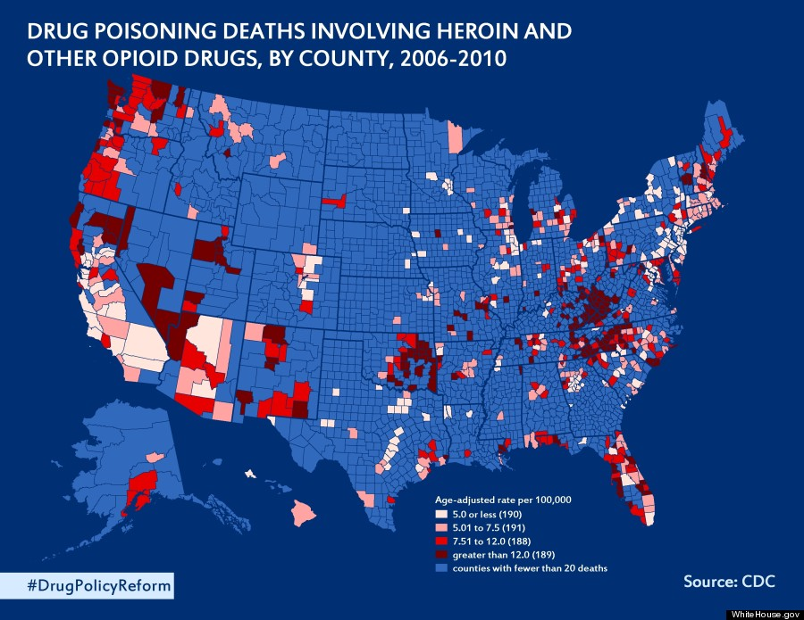

Slide 33
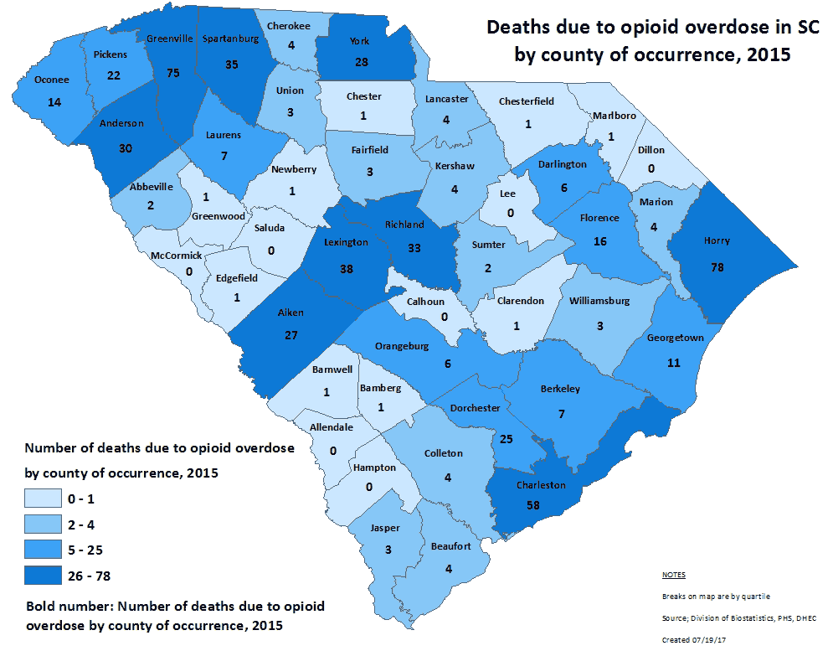

Slide 34
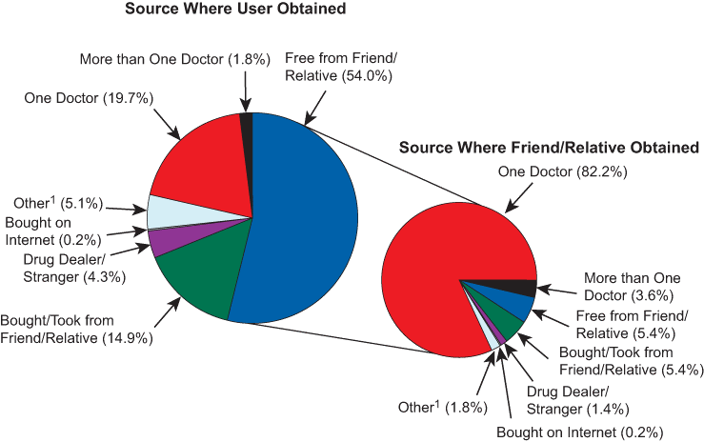

Slide 35
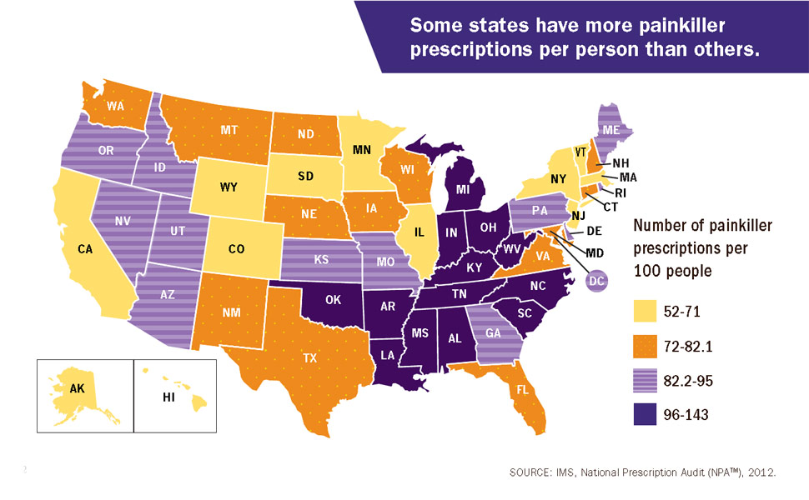

Slide 36
Opioid use disorder
Using more/longer than intended
Wanted to cut down but couldn’t
Spending a lot of time using opioids
Wanted to use badly-craving
Using caused trouble with job or family
Continued to use in spite of trouble
Given up activities in order to use
Gotten into a dangerous situation
Continuing to use in spite of health issues
Have to use more to get the same effect
Experience withdrawal when the opioid wears off

Slide 37
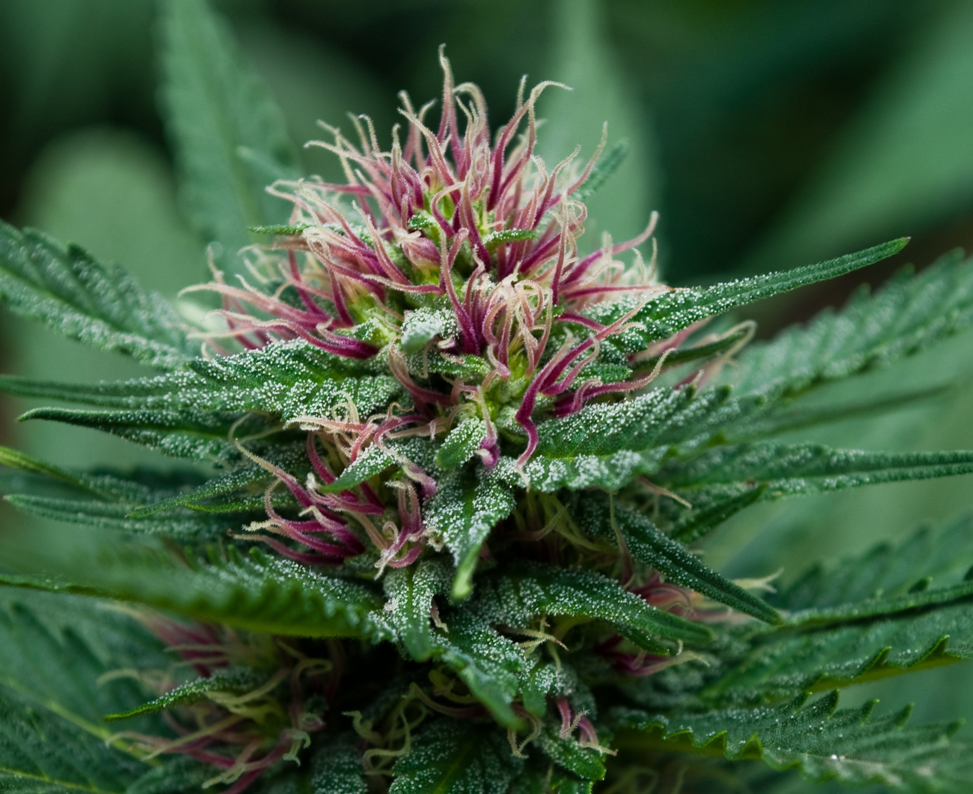
marijuana

Slide 38
What is marijuana, cbd, thc
Marijuana comes from the Cannabis Sativa plant the flower buds, leaves, resin contain the highest THC concentrations
Delta-9 THC is the main psychoactive compound
Hemp is from the stalks and sterilized seeds
Hemp comes from the same plant and contains THC and it is legal in certain instances
THC in marijuana plants can vary from 10% to 30%
CBD oil is marijuana concentrate up to 40-80% THC

Slide 39
Marijuana legal fed vs state
It is a Schedule I substance under the Controlled Substances Act
High abuse potential, no accepted medical use, lack of safety under medical supervision
The FDA has the federal authority to approve drugs for medicinal purposes
FDA and the DEA conclude there is no medical use and it remains a schedule I

Slide 40
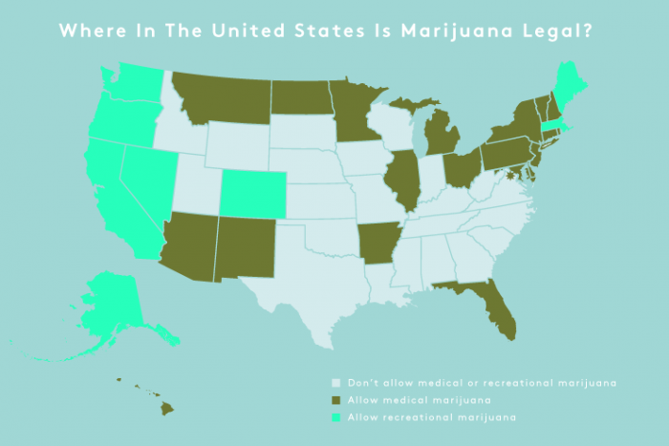

Slide 41
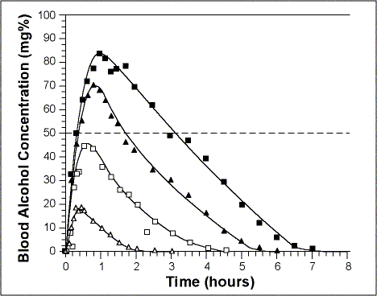
Alcohol blood concentrations

Slide 42
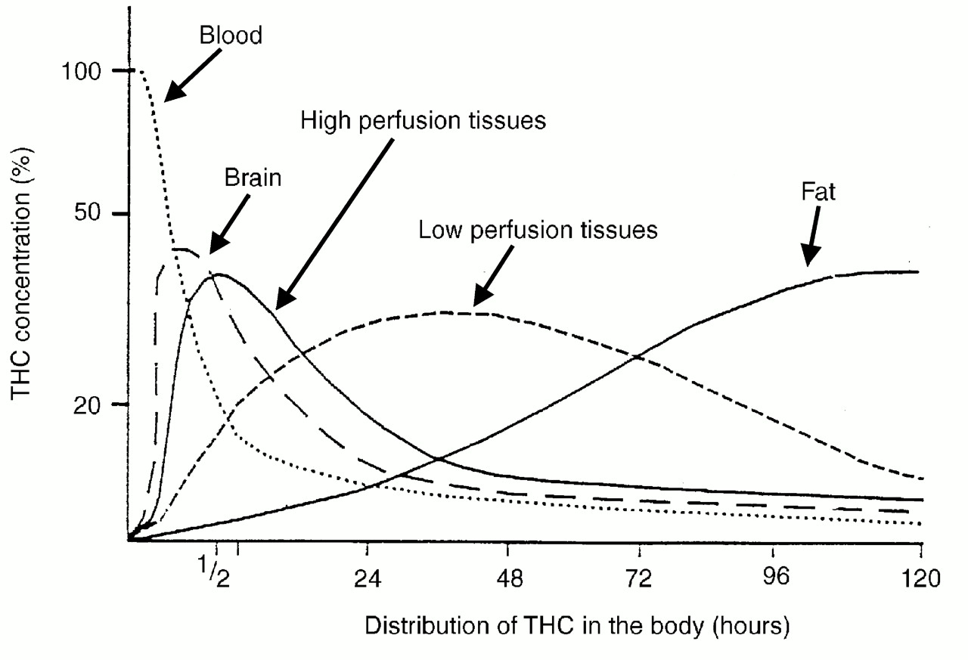
Marijuana blood concentration

Slide 43
Marijuana effects
Acute ; unto 6 hours
drowsy, lackadaisical decreased response time, focus, concentration decreased ability to judge distance, space and time impaired balance, memory
Intermediate; 24-48 hours
decreased hand eye coordination prolonged lack of motivation
Long term; up to 30 days
amotivational syndrome, apathy, lethargy, can’t complete task lack of ambition to seek and maintain employment

Slide 44
Obstacles in legalization
Too many forms, potencies, additives, contaminants for the FDA to assess efficacy
DEA does not permit marijuana for research in universities receiving federal funding
Pharmaceutical companies provide the majority of research and development for new drugs.
They recoup their investment through patents

Slide 45
conclusions
SUD is a chronic brain disease that is genetic and environmental
SUD is developmental and likely starts in adolescence
Alcohol, opioids, and marijuana are the most prevalent substances of abuse in the workplace
SUD has a huge negative economic impact on businesses
Marijuana legalization is fraught with many issues that need to be addressed

